Slide 1
Ansible Inventory

Slide 2

Agenda
Inventory File
Hosts and Groups
Host Variables
Group Variables
Aliases
Inventory Parameters

Slide 3
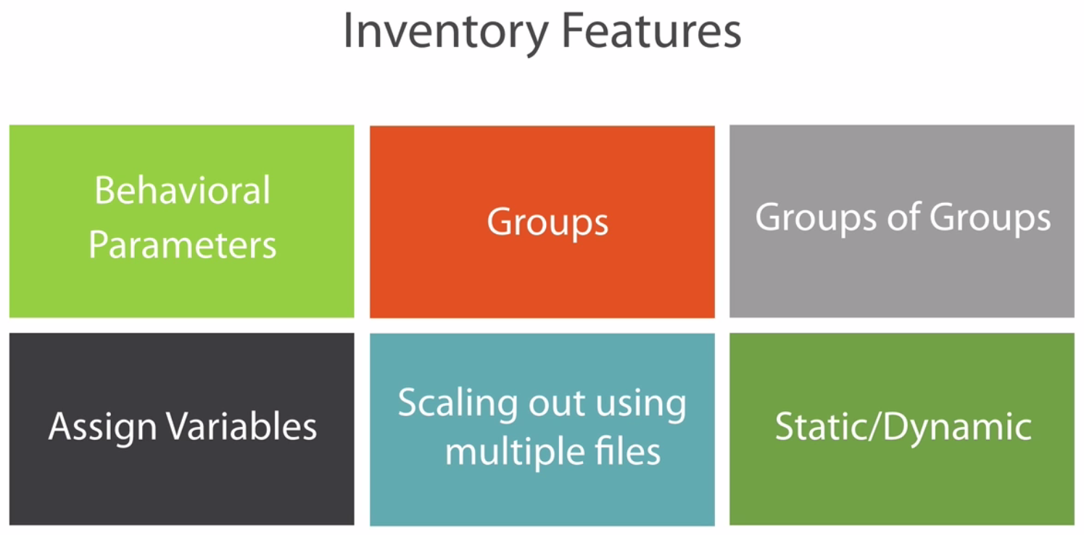
Inventory File

Slide 4
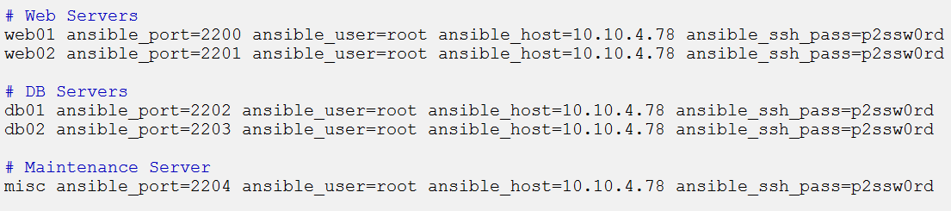
Inventory File
Defaults to being saved in the location /etc/ansible/hosts
Can specify a different inventory file using the -i <path> option
Hosts
Hosts alias are created inside inventory file along with behavioral parameters.

Slide 5
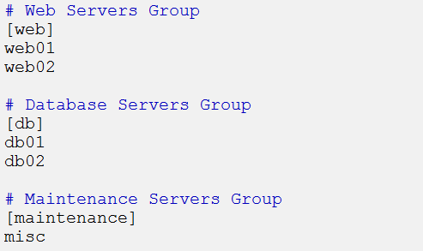
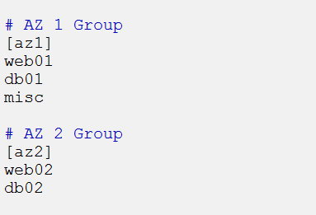
Inventory File
Groups
Hosts defined inside the inventory file can be grouped together.
The grouping of hosts can be done as per the ease and requirement.
One host can be defined under multiple groups.

Slide 6
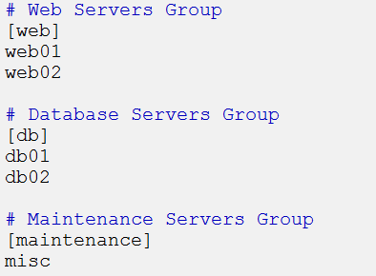
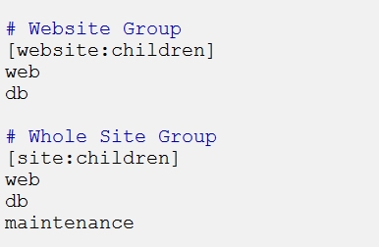
Inventory File
Group of Groups
Multiple groups can be defined under one group.

Slide 7
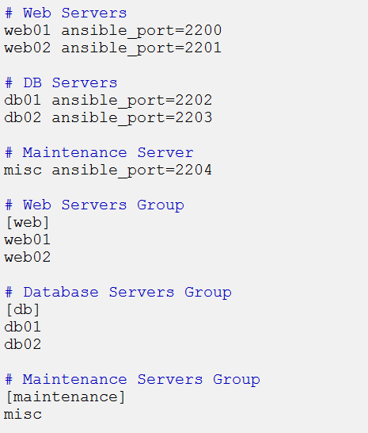
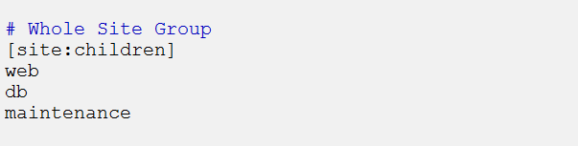
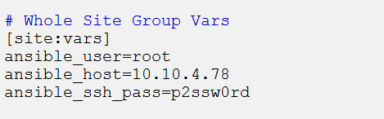
Inventory File
Group Parameters
Behavioural parameters can also be defined for the groups as well.

Slide 8
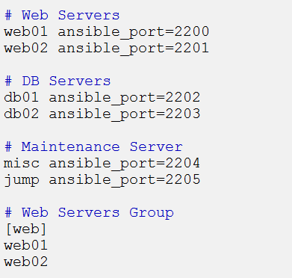
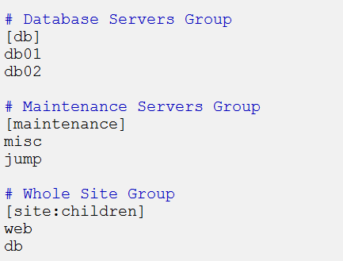
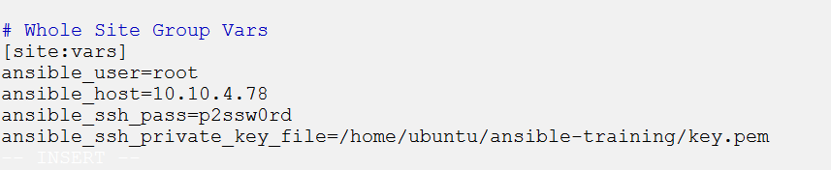
Inventory File
Group Parameters
It is generally prefered to use key based login instead of using password.

